Slide 1

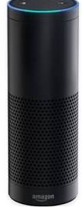


New Product Sentiment Analysis Using Twitter
Cheng cheng, K Iwasaki, David Larance
W205 – Section 2
Progress Report

Slide 2
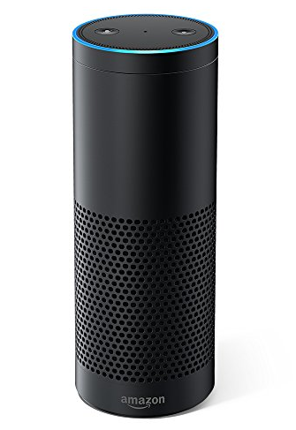
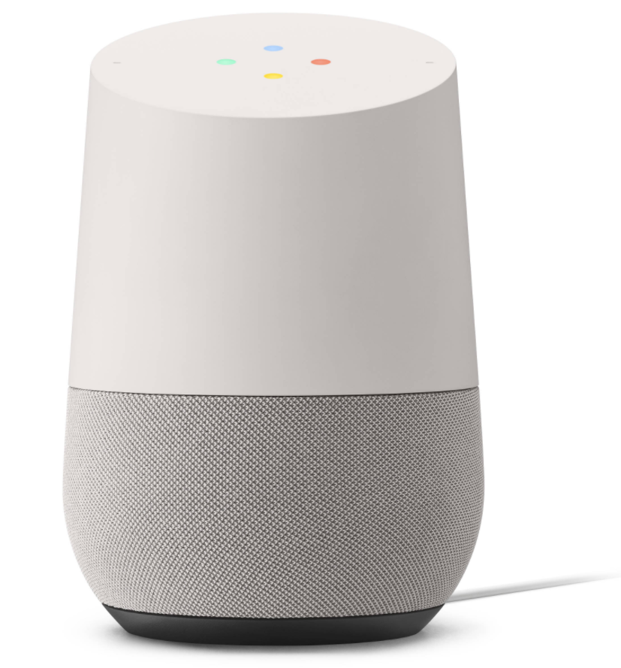

Project Summary
Build data architecture to systematically collect, store, process and visualize Tweets about new products
Project concept
Domain: Smart speaker
Tweets,
ReTweets &
Mentions
Reporting
Data Analysis
Google Home
Amazon Echo

Slide 3
Progress Summary
Researched and designed data architecture for the project based on assessment of demands of the processing and analysis
Tested twitter APIs and collected tweets including some key words related to the selected products
Tested some basic sentiment analysis to learn mechanics of sentiment analysis and looking for ways to integrate the analysis into the data architecture
Notes:
Data collection
Used tweepy to collect tweets including keywords related to the selected products
Cleaned-up data by removing “http//…”
Stored the data in csv format
Sentiment Analysis
Implemented some basic sentiment analysis
Currently working on ways to integrate it into data architecture

Slide 4







Data Architecture
Data source
Data storage
Data processing
Sentiment analysis
Data visualization

Slide 5
Tasks for the remaining weeks
Collect larger data (5GB >) by utilizing twitter API without damaging twitter credential
Define analytics metrics for tweets and collect data accordingly
Load the data into HDFS. Might explore better options than “HDFS put” command
Analyze the data with pyspark and sentiment analysis modules
Visualize insights from the analysis by utilizing tableau

